Slide 1
สมาชิก
นาย อติกันต์ กันนาง 622110340
นาย ธนกร จันทร์ซา 632110338
นาย ปกรณ์ ศิลปประภา 632110345
นางสาว พีรยา บุญยะวิโรจน์ 632110349
นางสาว สุธีรา ปรีย์นันท์ 632110356
นางสาว เสาวลักษณ์ เจียวใช่เฮ็ง 632110357

Slide 2
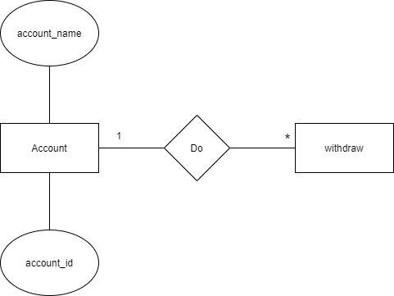
Example 0
Name | Description | Data type | Size | Key | Example
account_id | Id is the identity of each account | varchar | 10 | primary | 0123456789
account_name | The name of owner account | varchar | 50 |  | Pakorn wwwwwwasd

Slide 3
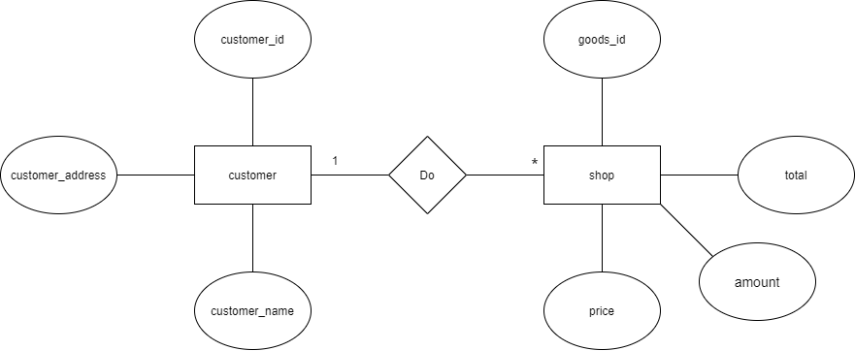
Example 1

Slide 4
Example 1
customer
Name | Description | Data type | Size | Key | Example
customer_id | Id is the identity of each customer | varchar | 4 | primary | 0001
customer_name | The name of customer | varchar | 50 |  | มานะ ดวงดี
customer_address | The address of customer | varchar | 100 |  | อ.เมือง สารคาม

Slide 5
Example 1
Goods
Name | Description | Data type | Size | Key | Example
goods_id | Id is the identity of each goods | varchar | 4 | primary | 0001
goods_name | The name of goods | varchar | 50 |  | น้ำถัง
goods_price | The price of goods | double | 100 |  | 10.00
goods_amount | The amount of goods | int | 10,000 |  | 60
goods_total | The tatal of goods | double | 1,000,000 |  | 920.00

Slide 6
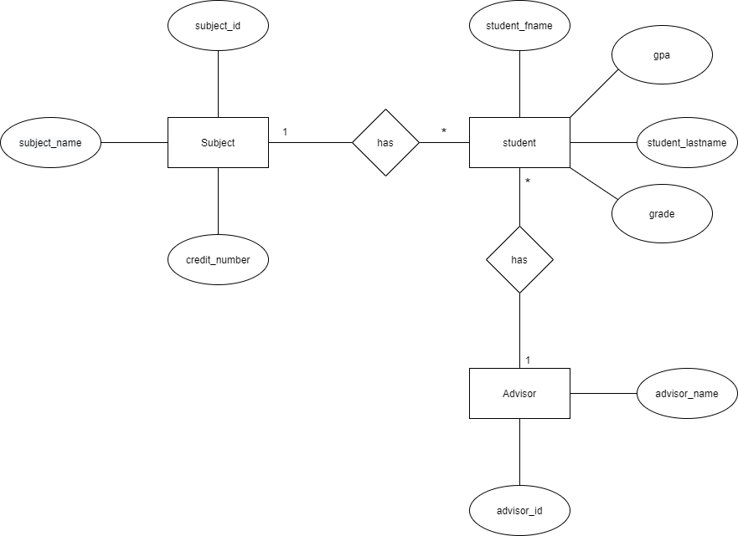
Example 2

Slide 7
Example 2
Subject
Name | Description | Data type | Size | Key | Example
subject_id | Id is the identity of each subject | varchar | 6 | primary | 960001
subject_name | The name of subject | varchar | 50 |  | สวัสดีชาวโลก I
credit_number | The credit of subject | varchar | 1 |  | 3

Slide 8
Example 2
Student
Name | Description | Data type | Size | Key | Example
student_id | Id is the identity of each student | varchar | 3 | primary | 001
student_fname | The first name of student | varchar | 20 |  | นาย ก
student_lastname | The last name of student | varchar | 20 |  | สวัสดีครับ
grade | The grade of student | varchar | 1 |  | A
gpa | The gpa of student | double | 3 |  | 3.50

Slide 9
Example 2
Advisor
Name | Description | Data type | Size | Key | Example
Advisor_id | Id is the identity of each Advisor | varchar | 3 | primary | 001
Advisor_name | The first name of Advisor | varchar | 20 |  | Earth

Slide 10
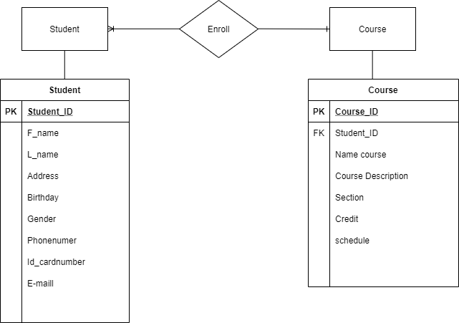
Example 3

Slide 11
Example 3
Student Table
Name | Description | Data type | Size | Key | Example
student_id | Id is the identity of each student | varchar | 9 | primary | 622110111
F_name | The first name of student | varchar | 20 |  | Justin
L_name | The last name of student | varchar | 20 |  | Bieber
Address | The address of student | varchar | 100 |  | 25202 Prado Del Grandioso CalabasasCalifornia, United States.
Birthday | Birthday of student | date | 8 |  | 1/1/1998
Gender | The Gender of student | char | 1 |  | M
Phonenumber | The phonenumber of student | varchar | 10 |  | 0812354678
Id_cardnumber | The id cardnumber of student | varchar | 13 |  | 1508860234567
E-mail | The email of student | varchar | 30 |  | justinbb@gmail.com

Slide 12
Example 3
Course Table
Name | Description | Data type | Size | Key | Example
Course_ID | Id is the identity of course | varchar | 6 | primary | 960121
Student_ID | Id is the identity of each student | varchar | 9 | foreign | 622110111
Name course | The Name course | varchar | 50 |  | DIGITAL INDUSTRY PROCESS 1
Course Description | Description of the course how to study | varchar | 1,000 |  | Introduction to digital industry and career. Job characteristics, necessary knowledge, attitude and preferable characteristics. Digital professionalism and development. Ethics in information system. Code of ethics and acceptable use policies. Digital intellectual property and permission to use. First sale doctrine. Privacy from the information systems perspective. Case studies in digital industry.
Section | Section of course | varchar | 3 |  | 001
Credit | Credit of course | varchar | 3 |  | 3.00
schedule | Date / time of course | Date Time | 20 |  | M-F 9.00-16.00

